Slide 1
WELCOME

Slide 2
PPT-PRESENTAION BY
B.AUGUSTINE AROCKIARAJ
DEPT.OF.BUSINESS ADMINISTRATION,
ST.JOSEPH’S COLLEGE(AUTONOMOUS),
TRICHIRAPPALLI.-02

Slide 3
BUSINESS COMMUNICATION
UNIT-1

Slide 4
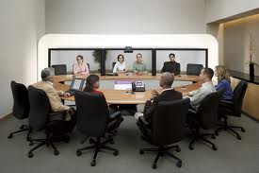

Slide 5
What is communication?
communication is the process by which information is transmitted between individuals and organisation so that an understanding response results.

Slide 6
IMPORTANT POINTS OF COMMUNICITION:
1.THE PROCESS OF COMMUNICATION INVOLVES THE COMMUNICATION OF IDEAS.
2.THE IDEA SHOULD BE ACCURATELY REPLICATED IN THE RECIEVAR MIND.
3.THE TRANSMITTER IS ASSURED OF THE ACCURATE REPLICATION OF THE IDEAS BY FEEDBACK.
4.THE PURPOSE OF ALL COMMUNICATION IS TO ELICINT ACTION.

Slide 7
COMMUNICATION CYCLE:
INPUT
CHANNEL
MESSAGE
OUTPUT
FEEDBACK
BRAIN DRAIN
OUTPUT.

Slide 8
MAIN OBJECTIVES OF COMMUNICATION:
INFORMATION
ADVICE
ORDER
SUGGESTION
PERSUATION
EDUCATION
WARNING
RASING MORALE
MOTIVATION.

Slide 9
TYPES OF COMMUNICATION:
DOWNWARD COMMUNICATION
UPWARD COMMUNICATION
HORIZONTAL COMMUNICATION
GRAPEVINE .

Slide 10
COMMUNICATION PATTERN:
BOARD OF DIRECTORS
MANAGING DIRECTOR
DEPT.MANAGERS
SUPERVISORS
CLERKS&OPERATIVES
RECTOR
PRINCIPAL
H.O.D
MENTOR
STUDENTS.

Slide 11
COMMUNICATION PATTERN:
BOARD OF DIRECTORS
MANAGING DIRECTOR
DEPT.MANAGERS
SUPERVISORS
CLERKS&OPERATIVES
RECTOR
PRINCIPAL
H.O.D
MENTOR
STUDENTS.

Slide 12
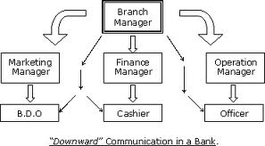
DOWNWARD COMMUNICATION:

Slide 13
OBJECTIVES:
TO GIVE DIRECTIVES ABOUT SOME JOB.
TO EXPLAIN POLICIES AND PROCEDURE.
TO CONVEY ASSESSMENT OF PERFORMANCE.
TO EXPLAIN THE RATIONALE OF THE JOB.

Slide 14
LIMITATIONS:
IN CASE OF LONG LINE OF COMMUNICATION, THERE MAY BE,
DELAY
LOSS OF INFORMATION
DISTORTION
RESENTMENT BY SUBORDINATE STAFF.

Slide 15
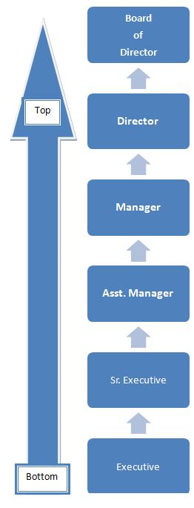
UPWARD COMMUNICATION:

Slide 16
IMPORTANCE:
PROVIDE FEEDBACK TO SUPERIORS.
PROMOTES HARMONY.
RELEASSES THE PENT-UP EMOTIONS.
MAKE THE INTRO OF NEW SCHEMES EASIER.
PROVIDES THE SUPERIORS WITH USEFUL SUGGESTIONS.

Slide 17
LIMITATIONS:
EMPLOYEES ARE RELUCANT TO EXPRESS THEMSELVES.
GREAT POSSIBILITY OF DISTORTION.
BY PASSED SUPERIORS FEEL INSULTED.
EMPLOYEES FEAR THAT CRITICISM MAY BE INTERPRETED.

Slide 18
HORIZONTAL COMMUNICATION:

Slide 19
HORIZONTAL COMMUNICATION:
IN THIS COMMUNICATION FLOWS BETWEEN PEOPLE AT THE LEVEL.
IT IS IMPORTANCE FOR PROMOTING UNDERSTANDING AND CO-ORDINATION AMONG VARIOUS PEOPLE.
CARRIED ON
FACE-TO-FACE DISCUSSION.
TELEPHONIC TALK
MEMOS.

Slide 20
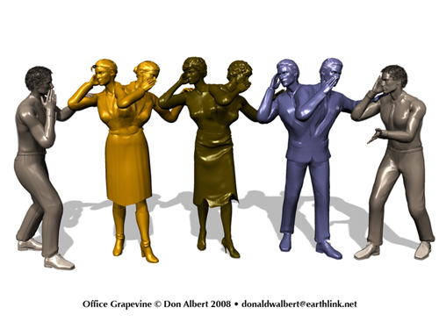
GRAPEVINE

Slide 21
4 TYPES:

Slide 22
IMPORTANCE OF GRAPEVINE:
A SAFETY VALUE
ORGANISATIONAL SOLIDARITY AND COHESION
SUPPLEMENT TO OTHER CHANNELS
QUICK TRANSMISSON
FEEDBACK.

Slide 23
DEMERITS OF GRAPEVINE:
DISTORTION
INCOMPLETE INFORMATION
DAMAGING SWIFTNESS.

